Slide 1
Task Manager with Progress Tracker –
A Productivity Enhancement Tool
CAPSTONE PROJECT
“Streamlining Task Management with Real-time Progress Monitoring”
Presented By:
Abhay Maurya - Uttarakhand Technical University - B-Tech CSE
STU687a1927d41891752832295

Slide 2
OUTLINE
Problem Statement (Should not include solution)
System Development Approach (Technology Used)
Algorithm & Deployment (Step by Step Procedure)
Result
Conclusion
Future Scope(Optional)
References

Slide 3
PROBLEM STATEMENT
Managing daily tasks is often overwhelming due to poor prioritization and lack of progress visibility.
Traditional methods fail to track time efficiently and give limited productivity insights.
Our objective is to build an intuitive web-based system with simple task organization and real-time tracking.
Success will be measured through improved task completion, usability, and reliable performance.

Slide 4
SYSTEM APPROACH
Frontend Technologies:
HTML5: Semantic structure, forms, local storage API support
CSS3: Flexbox/Grid layouts, theming with variables, responsive design
JavaScript (ES6+): DOM manipulation, event handling, local storage management
Design Approach:
Clean and user-friendly interface
Mobile-responsive design
Modular separation of HTML, CSS, and JS files

Slide 5
SYSTEM APPROACH
HTML – Structure & Accessibility
Defined the overall page layout (header, task list section, footer).
Built task forms for adding/editing tasks.
Used semantic elements (form, button, section) for clarity and accessibility.
Integrated deadline and priority inputs directly in the markup.
Provided the foundation for JavaScript and CSS integration.

Slide 6
SYSTEM APPROACH
CSS – Styling & Responsive Design
Implemented flexbox and grid for adaptive layouts.
Designed dark/light theme toggle using CSS variables.
Styled progress bars, priority labels, and deadlines for clear visual cues.
Added animations and hover effects for smoother interactions.
Used media queries for full responsiveness (desktop → mobile).

Slide 7
SYSTEM APPROACH
JavaScript – Logic & Interactivity
Powered CRUD operations (create, edit, delete, complete tasks).
Managed localStorage persistence to save tasks across sessions.
Calculated progress percentage dynamically as tasks updated.
Built time tracking functions (start, stop, efficiency calculation).
Implemented sorting, filtering, and search features.

Slide 8
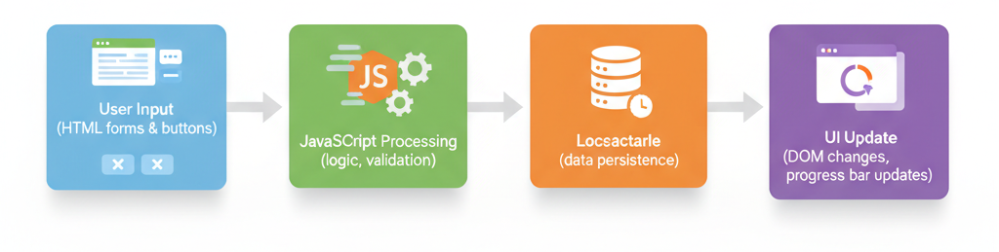
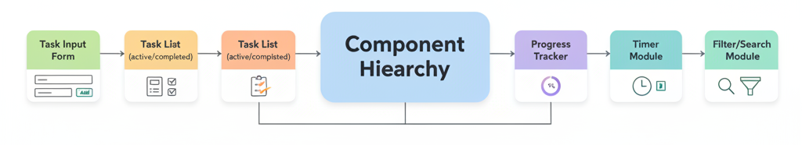
ALGORITHM & DEPLOYMENT
System Architecture Overview
Client-Side Single Page Application (no backend server).
Data Flow:
Component Hierarchy:

Slide 9
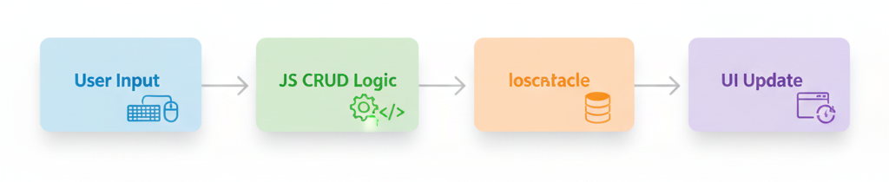
ALGORITHM & DEPLOYMENT
Task Management Algorithm
Input: User task data (title, description, priority, deadline).
Processing:
Create → Save new task in localStorage.
Read → Load tasks on page load.
Update → Edit task details, status, or priority.
Delete → Remove task from localStorage.
Output: Organized and updated task list.
Flow:

Slide 10
ALGORITHM & DEPLOYMENT
Progress & Time Tracking Algorithms
Progress Calculation:
Formula: (Completed Tasks ÷ Total Tasks) × 100
Updates progress bar and completion percentage in real-time.
Time Tracking:
Start/Stop timers for individual tasks.
Efficiency Formula: (Actual Time ÷ Estimated Time) × 100
Stores tracked time in localStorage for persistence.

Slide 11
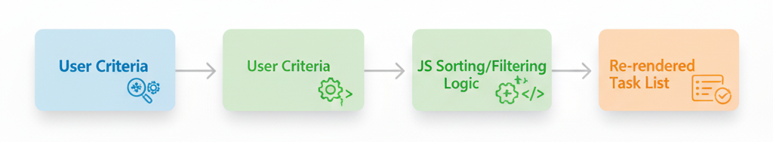
ALGORITHM & DEPLOYMENT
Sorting, Filtering & Search Algorithms
Sorting Algorithms:
Sort tasks by priority, deadline, or creation date.
Filtering Algorithms:
Filter by status (completed/pending), priority, or deadline proximity.
Search Algorithm:
Real-time search → Filters tasks as user types by title or description.
Workflow:

Slide 12
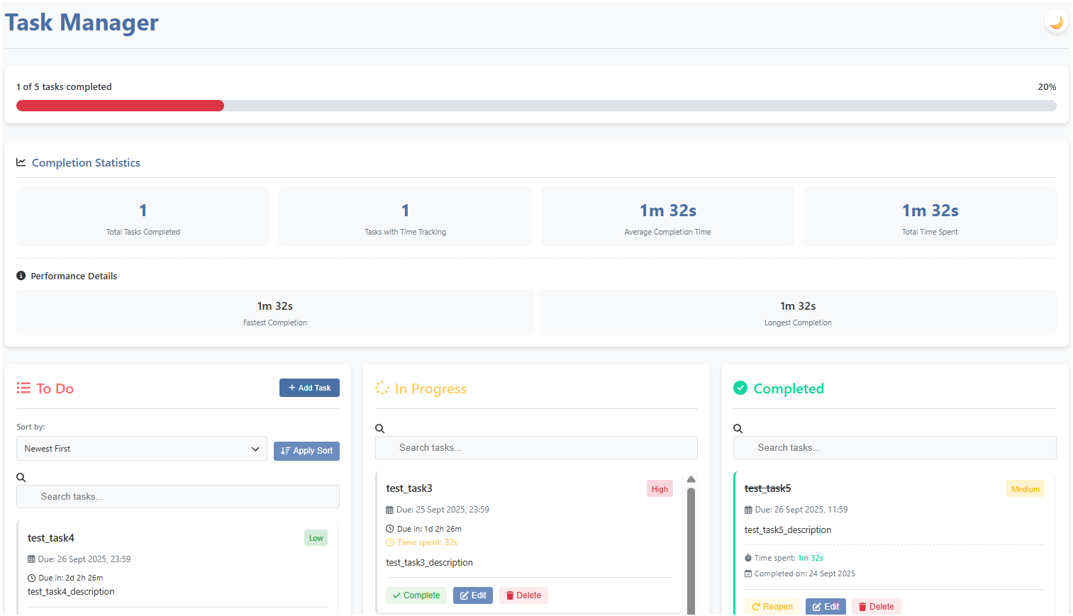
RESULT
Github repo: https://github.com/abhay1maurya/task-manager-app
Application link: https://task-manager-app-abhay.vercel.app/

Slide 13
CONCLUSION
Key Takeaways:
Addressed major productivity challenges in task management.
Achieved core objectives: intuitive UI, real-time tracking, time management.
Delivered reliable and responsive web app with local data persistence.
Value Proposition:
Enhances personal productivity and task visibility.
Simple, accessible, and cross-device compatible.
Provides a strong foundation for future feature expansion.

Slide 14
FUTURE SCOPE(OPTIONAL)
Planned Enhancements:
Cloud synchronization for multi-device access.
Dedicated mobile app (Android/iOS).
Advanced analytics with detailed productivity reports.
Team collaboration & shared task lists.
AI-powered task prioritization and suggestions.
Integration with popular calendars (Google, Outlook).

Slide 15
REFERENCES
Technical References:
MDN Web Docs (HTML5, CSS3, JavaScript).
W3C standards for semantic web development.
Development Tools:
Git & GitHub for version control.
Browser DevTools for debugging.
VS Code
Learning Resources:
Online tutorials, IBM SkillsBuild
UI/UX design guidelines and accessibility principles.

Slide 16
THANK YOU

